Slide 1
ASP.Net
Week 02 Lecture 01

Slide 2
Server-Side Code
What is server-side code?
Software that runs on the server, not the client
Receives input from
URL parameters
HTML form data
Can access server-side databases, e-mail servers, files, mainframes, etc.
Dynamically builds a custom HTML response for a client
HTTP request
(form data,
HTTP header data)
HTTP response HTML, XML
ASP page
(static HTML, server-side
logic)

Slide 3
Web Development
Which language(s) is/are understood by the browser?
HTML
JavaScript
CSS
What is the purpose of Server-Side Languages like ASP.Net, PHP, JSP, etc
What is meant by the terms “POST” and “GET”
GET has parameters in URL (Query String)
POST has parameters in the message header
Notes:
1- Ask students what are the things that the browser understands, once they have answered, clarify that only these 3 things are rendered.
2- JavaScript/Angular are client side languages, so what does ASP.Net/ PHP/ JSP do? Explain Static v/s dynamic websites and then transition into server-side explanation using an example request.
3- Ask about POST and GET. If they don’t recall, remind them html form tag and then explain that GET has its limitation of either 256 variables or size defined by the browser (can be 10MB of query string) where POST does not have such issues.

Slide 4
Area | Web application projects | Web site projects
Project file structure | A Visual Studio project file (.csproj or .vbproj) stores information about the project, such as the list of files that are included in the project, and any project-to-project references. | There is no project file (.csproj or .vbproj). All the files in a folder structure are automatically included in the site.
Compilation | - You explicitly compile the source code on the computer that is used for development or source control. - By default, compilation of code files (excluding .aspx and .ascx files) produces a single assembly. | - The source code is typically compiled dynamically (automatically) by ASP.NET on the server the first time a request is received after the site has been installed or updated. - You can precompile the site (compile in advance on a development computer or on the server). - By default, compilation produces multiple assemblies.
Namespaces | Explicit namespaces are added to pages, controls, and classes by default. | Explicit namespaces are not added to pages, controls, and classes by default, but you can add them manually.
Deployment | - You copy the assembly to a server. The assembly is produced by compiling the application. - Visual Studio provides tools that integrate with Web Deploy (the IIS web deployment tool) to automate many deployment tasks. | - You copy the application source files to a computer that has IIS installed on it. - If you precompile the site on a development computer, you copy the assemblies produced by compilation to the IIS server. - Visual Studio provides tools that integrate with Web Deploy (the IIS web deployment tool) to automate many deployment tasks.
Notes:
1- Next, Open VS and show them how an ASP.net project can be created. With this, explain the difference of Web App and Web Site. Web Site has individual dlls whereas Web App has one dll per project. Web Site does not have a project csproj file whereas Web App has one. You can explain other points as well from this slide
2- Explain that we have a page divided into three classes (.aspx – designer file for html/css, .cs – code behind for all server side logics, aspx.designer.cs as code behind for all html controls)
3- Explain that all asp.net controls will have runat=server in their elements, so you can either use asp.net controls or html controls directly. But asp.net controls can be accessed in code behind but not html ones
4- Show Full Post back example
5- walk through the example and show them how a button click can be bind with a code behind method (from properties)
6- Show Partial Post back example and explain jquery slightly and show the method in code behind which is static and has an attribute web method

Slide 5
ASP.NET Architecture
VB
C++
C#
JScript
…
Common Language Specification
ASP.NET: Web Services
and Web Forms
Windows Forms
Visual Studio.NET
ADO.NET: Data and XML
Base Classes
Common Language Runtime
Notes:
1- ASP.Net code can be used with C# or even VB.Net
ASP.NET is built upon
.NET Framework
Internet Information Server (IIS)

Slide 6
ASP.Net MVC
MVC Pattern
Controllers
View
Models (View Models v/s Database Models)
Notes:
1- Discuss what is an MVC Architecture
2- Ask students for VIEW and Controller
3- Discuss View Models and Data Models
4- Now show how an ASP.Net MVC Project can be created and then Show the MVC Project Example
5- Discuss the View Models in the example (a simple one and the one that has validators)
6- Create a model in class and create a View using that model (auto generate razor engine code)

Slide 7
Web Server
IIS
IIS Express
Notes:
1- When you run a web application/ website in Visual Studio , it runs on IIS Express. It is for development purpose only and cannot be connected from other machines.
2- To Host an application, you need to enable IIS in your windows machines.
3- IIS can host multiple websites, listening to same or different ports
4- App Pool under IIS has the .Net CLR Version so that the application or websites run with that particular version of CLR
5- Other settings like Application Timeout, Virtual memory allocated are defined under App Pool
6- Each Website has one App Pool but one App pool can have multiple websites

Slide 8
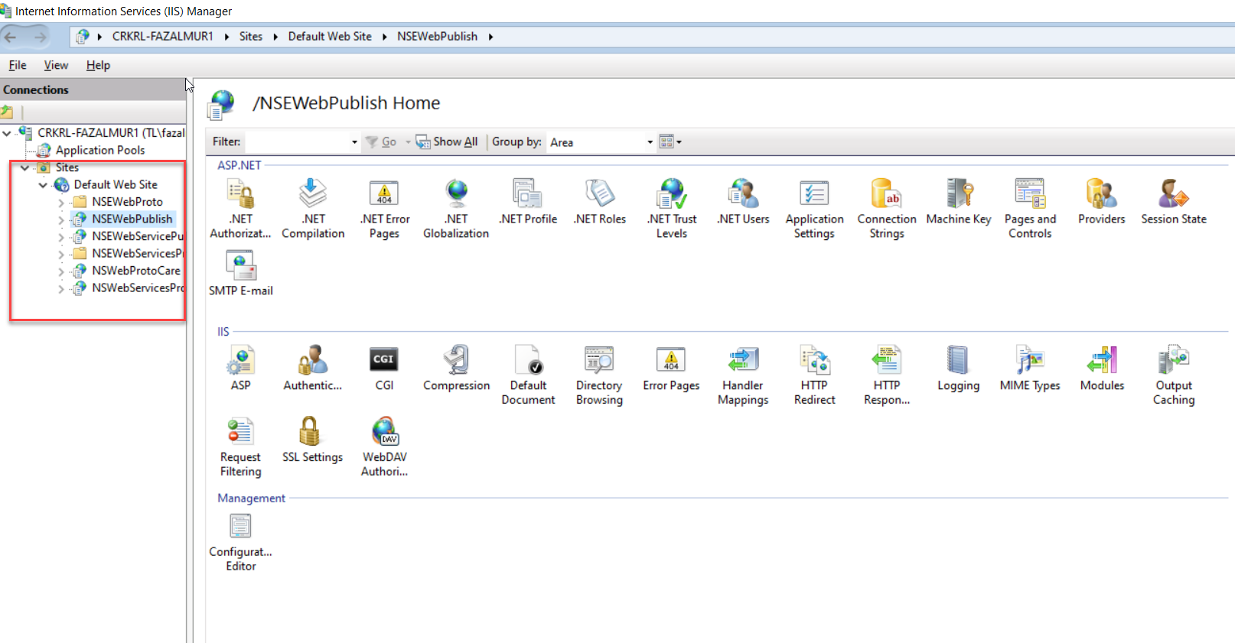
IIS - Sites

